Slide 1
Full Stack Presentation
Welcome To
On
Amazon Clone

Slide 2
About Project
The Project is based on Front End and Back End Web Development, in this project we have designed and created a Static website of an Amazon Clone. We have used HTML, CSS, JavaScript, Firebase and React JS to develop our website. This website is fully responsive and quite good colours and arrangement of different items.

Slide 3
Project Description
Amazon Clone wish to be one or other way the same and if you want to start a site if you are planning to buy or sell your products directly and it should the clients without any damage so this will the best way you have chosen. then you have reached the right place. Our Amazon clone has all the relevant features and benefits that could result in bringing a hike to your business career. • Our Amazon Clone Script comes with Mobile Application – Both Android and IOS.
Amazon provides a platform for other retailers to sell products to buyers besides direct selling.
Amazon also earns revenue through its video- streaming app, Amazon prime and Kindle, an e- reader.
It doesn’t charge its retailer partners, but it retains a part of the selling price as commission.

Slide 4
Project Description
Advantages:
Major 3 key roles attached with Amazon Clone i.e., Admin, Seller & Buyers
Built with Secure and Powerful Technologies i.e., PHP & MySQL
Easily add each essential details which are mandatory in your website
Money making amazon clone for all key-role players.

Slide 5
Technologies Used
HTML5: HTML5 is a mark-up language used for structuring and presenting content on the World Wide Web. It is the fifth and latest major version of HTML that is a World Wide Web Consortium recommendation.
HTML is the standard mark-up language for creating Web pages.
HTML describes the structure of a Web page.
HTML consists of a series of elements.
HTML elements tell the browser how to display the content.
CSS3: Cascading Style Sheets (CSS) is a style sheet language used for describing the look and formatting of a document written in a mark-up language.
CSS describes how HTML elements are to be displayed on screen, paper, or in other media
CSS saves a lot of work. It can control the layout of multiple web pages all at once

Slide 6
JavaScript:
JavaScript often abbreviated as JS, is a programming language that conforms to the ECMA Script specification. JavaScript is high-level, often just-in-time compiled, and multi-paradigm. It has curly-bracket syntax, dynamic typing, prototype-based object-orientation, and first-class functions.
Alongside HTML and CSS, JavaScript is one of the core technologies of the World Wide Web. JavaScript enables interactive web pages and is an essential part of web applications. Most websites use it for client-side page behaviour, and all major web browsers have a dedicated JavaScript engine to execute it.
React JS:
React is a JavaScript library and React applications built on it run in the browser, NOT on the server. Applications of this kind only communicate with the server, when necessary, which makes them very fast compared to traditional websites that force the user to wait for the server to re-render entire pages and send them to the browser.
It’s declarative: React uses a declarative paradigm that makes it easier to reason about your application.
It’s efficient: React computes the minimal set of changes necessary to keep your DOM up-to-date.

Slide 7
Firebase:
Firebase is a backend platform for building Web, Android and IOS applications. It offers real time database, different APIs, multiple authentication types and hosting platform. This is an introductory tutorial, which covers the basics of the Firebase platform and explains how to deal with its various components and sub-components.
Firebase Features:
Real-time Database − Firebase supports JSON data and all users connected to it receive live updates after every change.
Authentication − We can use anonymous, password or different social authentications.
Hosting − The applications can be deployed over secured connection to Firebase servers.

Slide 8
Moving towards
Project

Slide 9
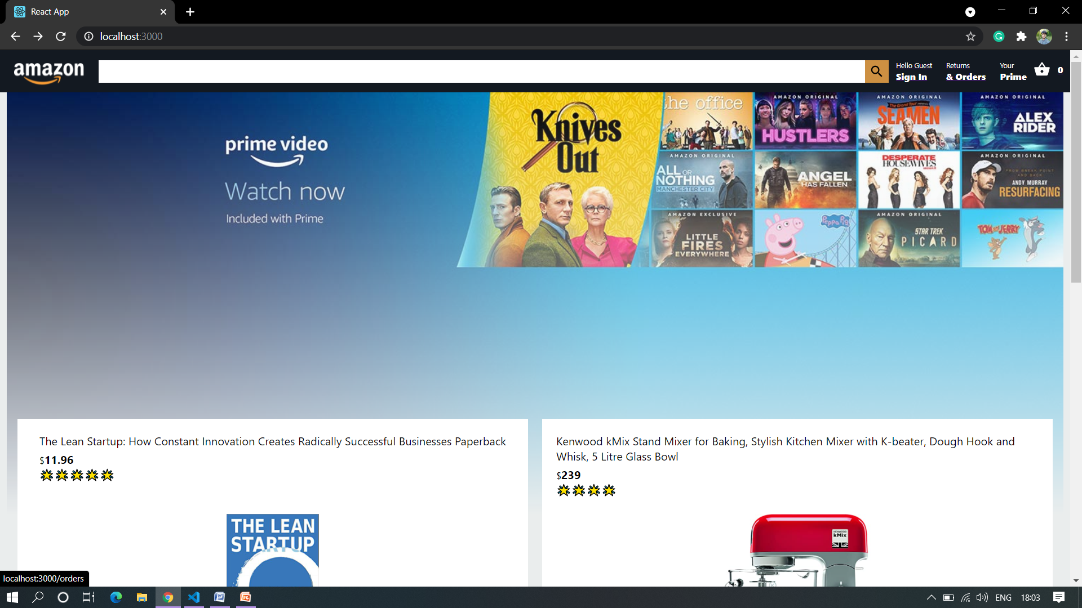
HOMEPAGE

Slide 10
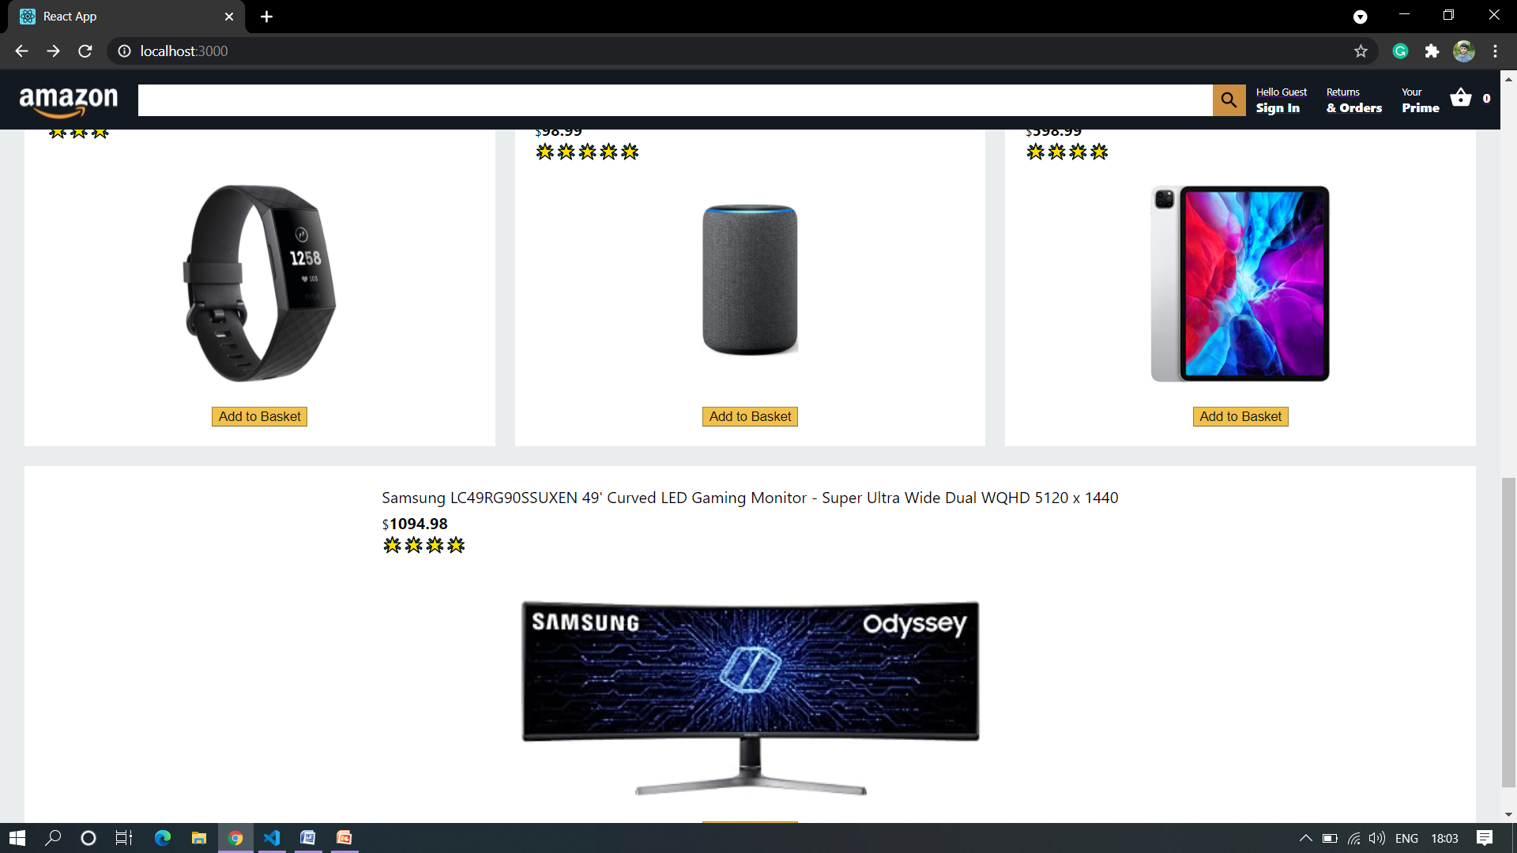
HOMEPAGE

Slide 11
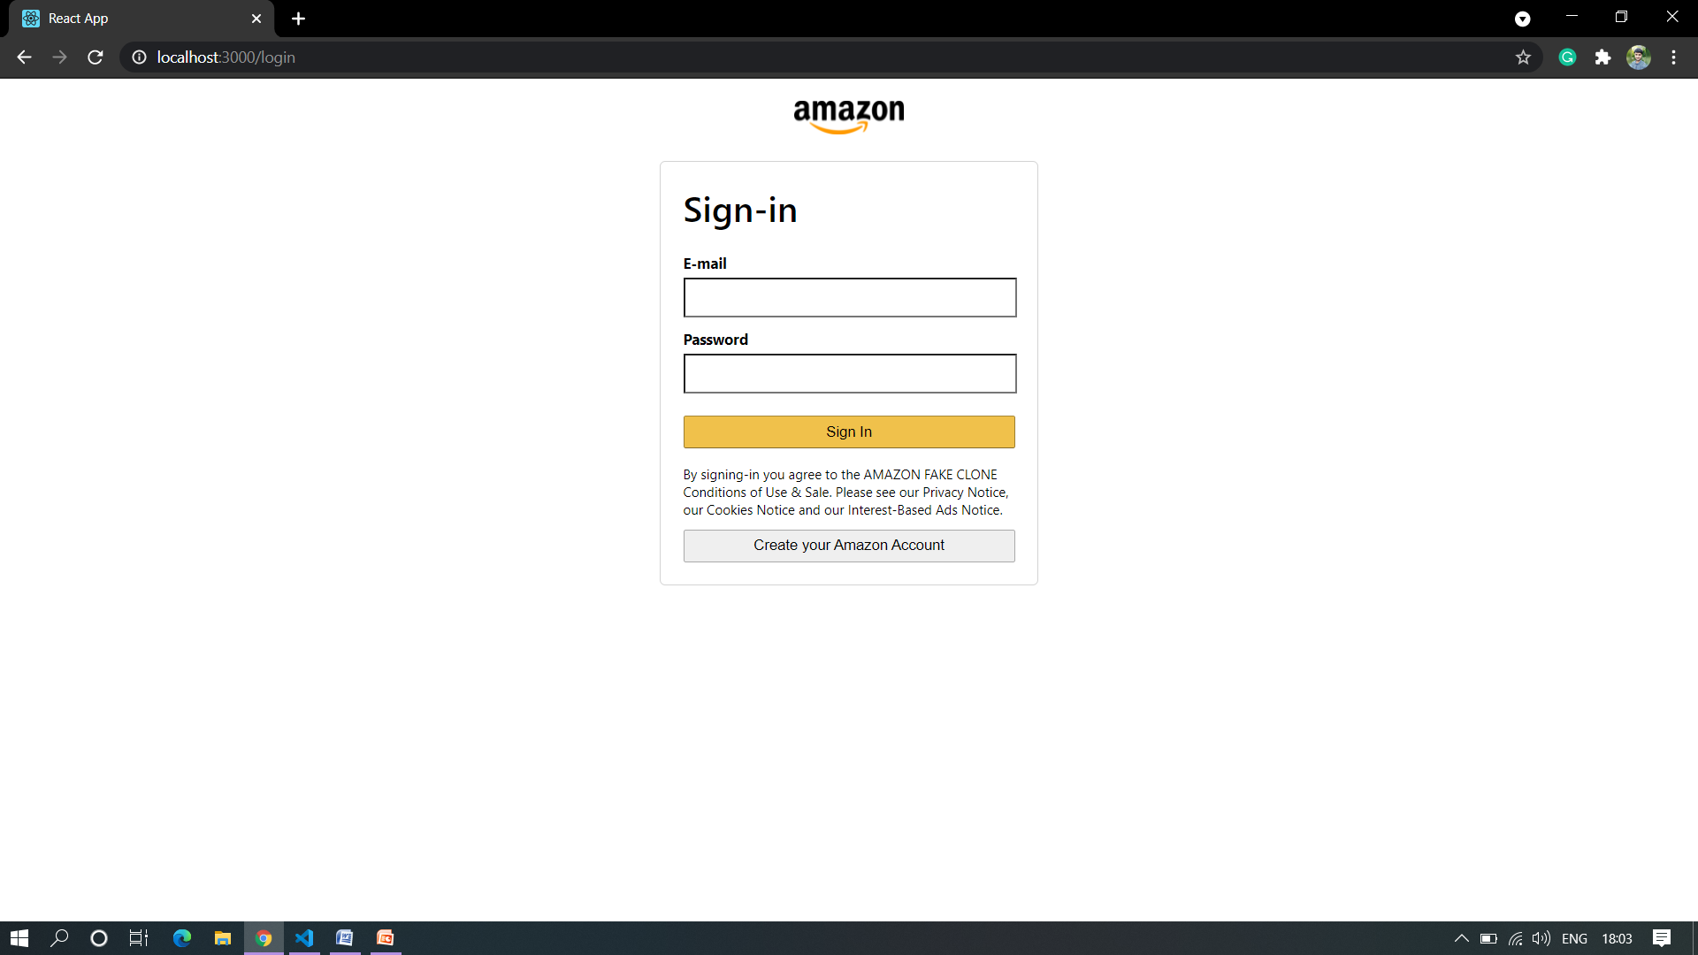

Slide 12
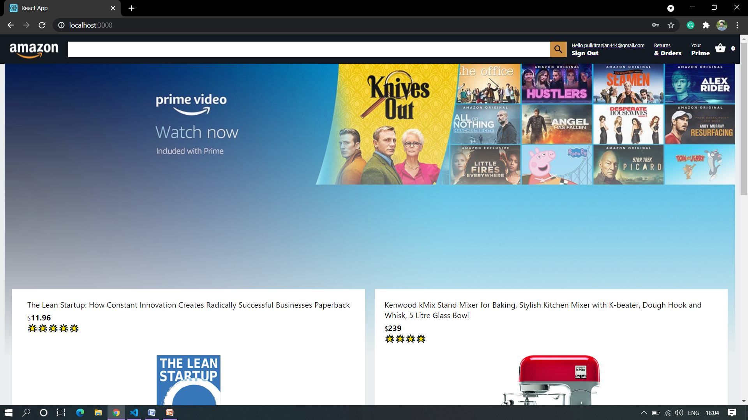

Slide 13
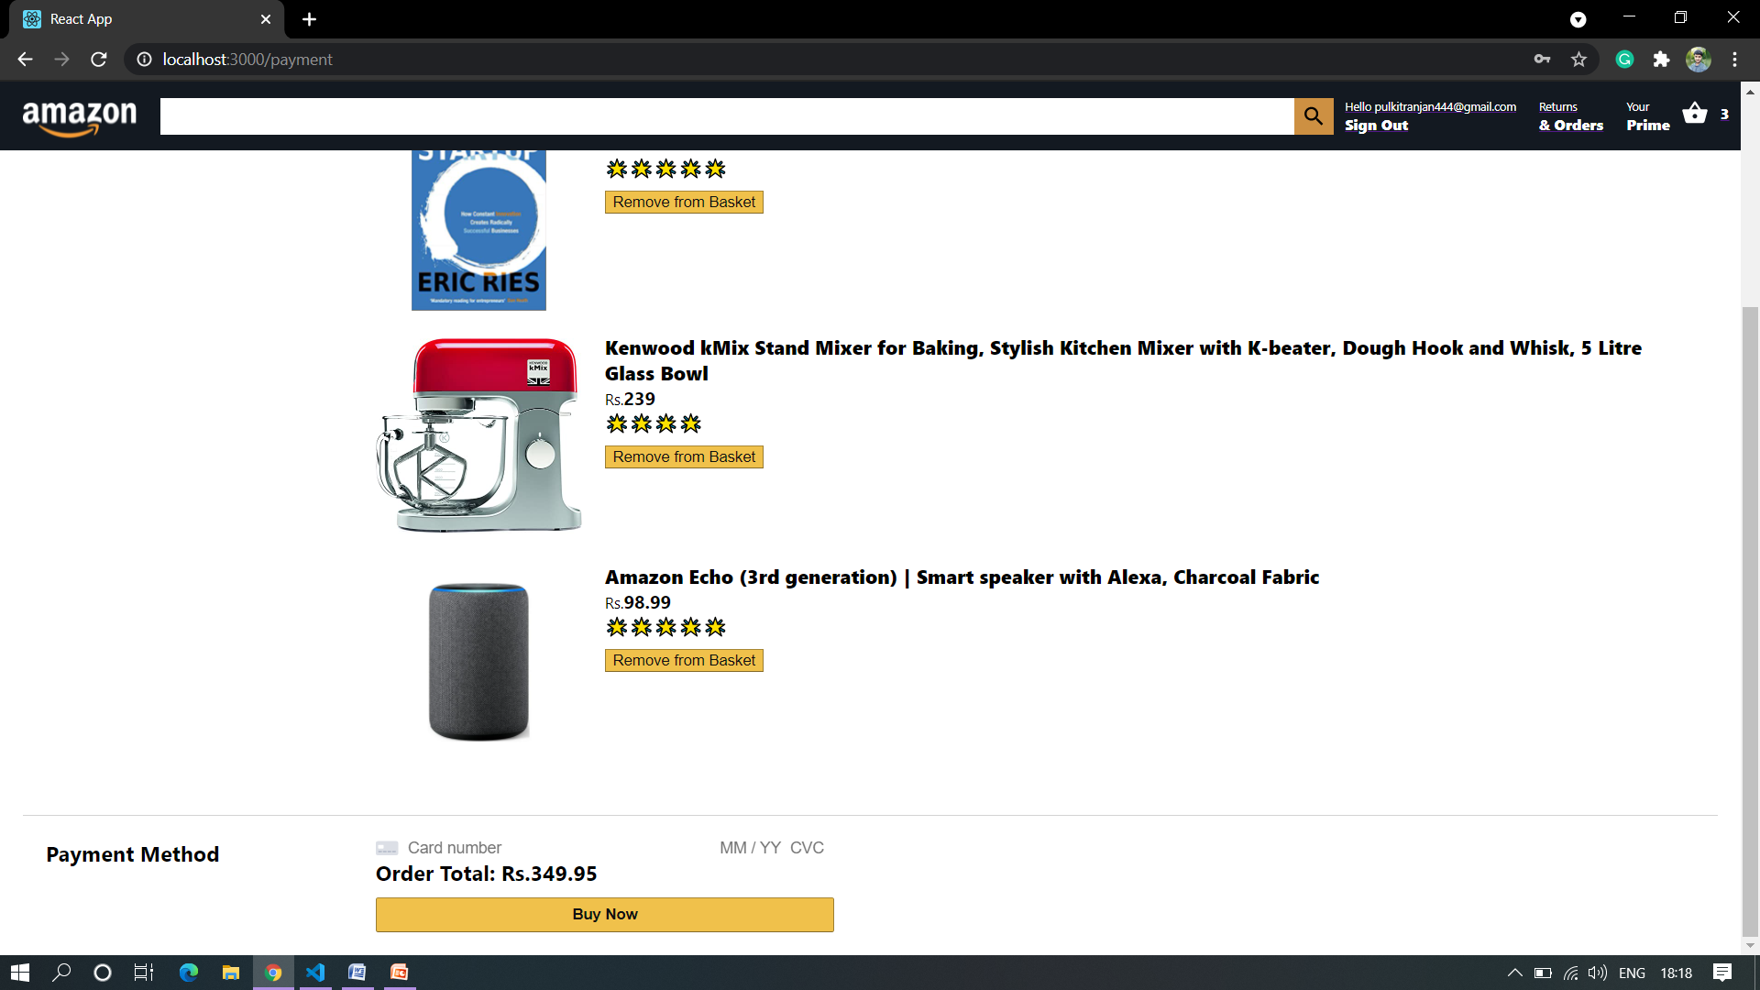

Slide 14
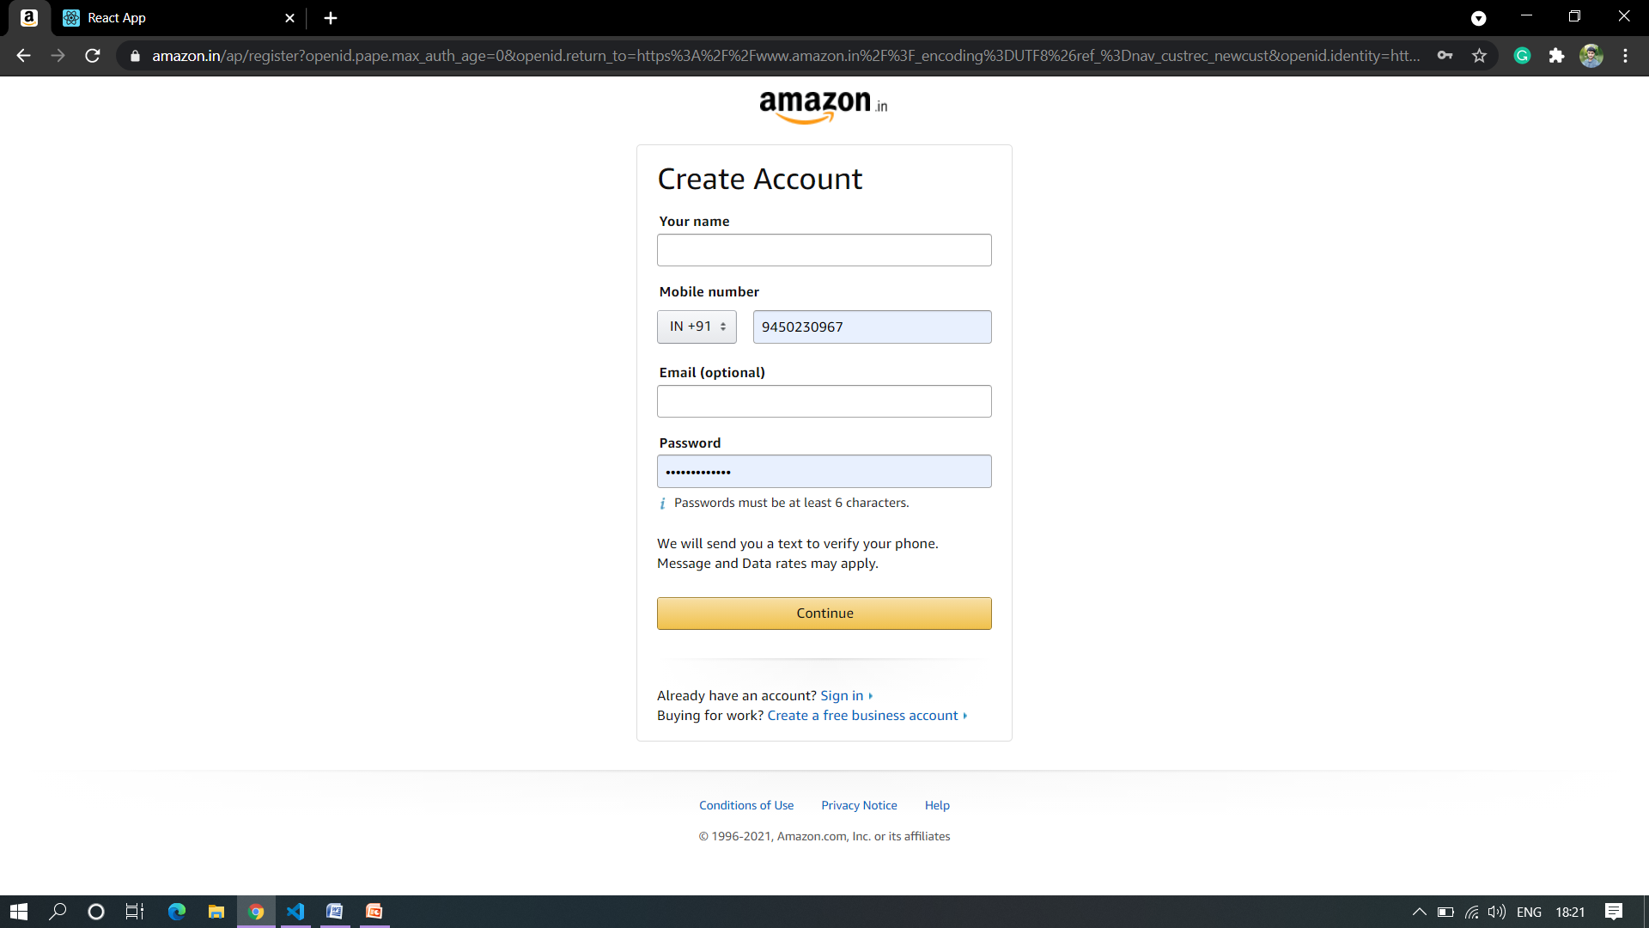

Slide 15


